Slide 1
LA GASTRONOMIE AQUITAINE
Arantxa Mota

Slide 2
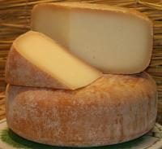
DIAPOSITIVE 1

Slide 3
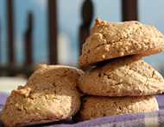
DIAPOSITIVE 2

Slide 4
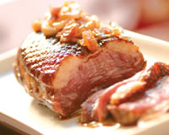
DIAPOSITIVE 3

Slide 5
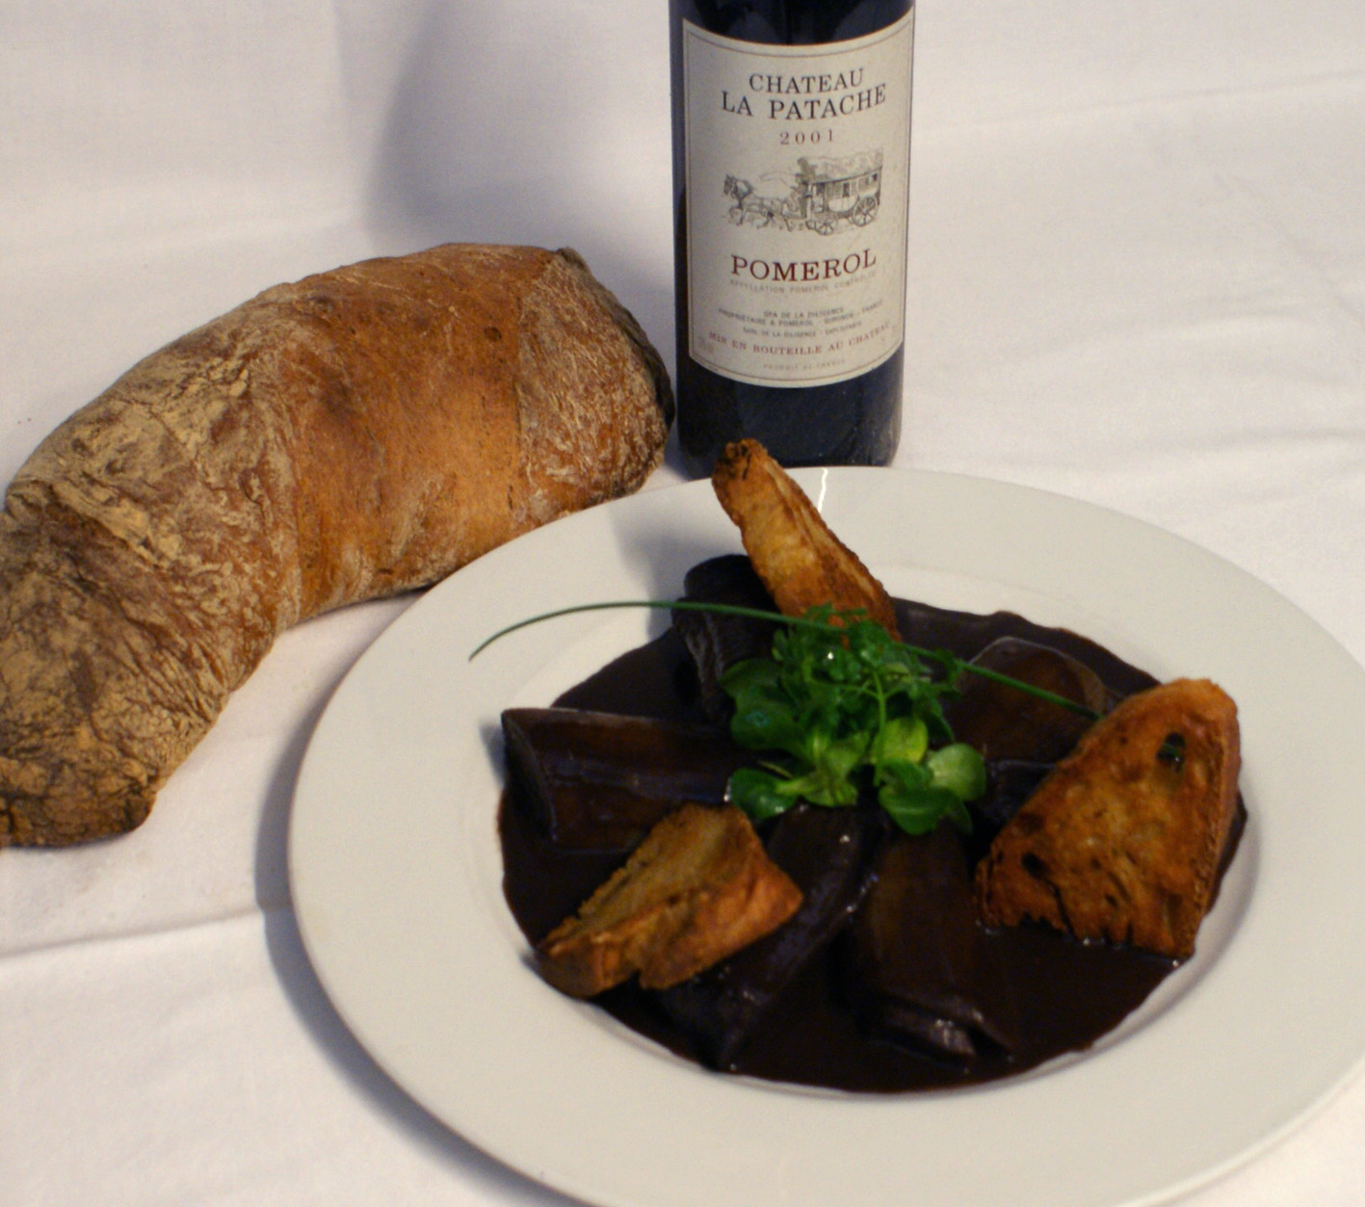
DIAPOSITIVE 4

Slide 6
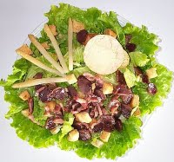
DIAPOSITIVE 5

Slide 7
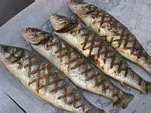
DIAPOSITIVE 6

Slide 8
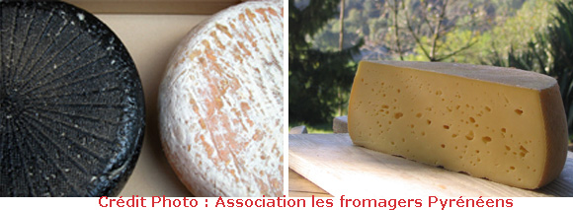
DIAPOSITIVE 7

Slide 9
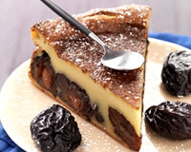
DIAPOSITIVE 8

Slide 10
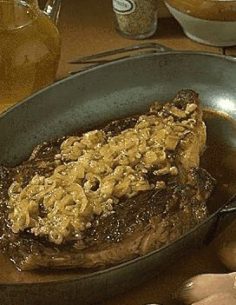
DIAPOSITIVE 9

Slide 11
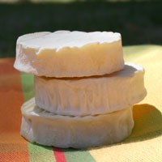
DIAPOSITIVE 10

Slide 12
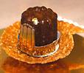
DIAPOSITIVE 11

Slide 13

DIAPOSITIVE 12

Slide 14
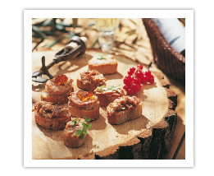
DIAPOSITIVE 13

Slide 15
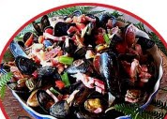
DIAPOSITIVE 14

Slide 16
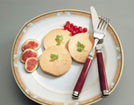
DIAPOSITIVE 15

Slide 17
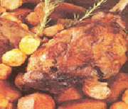
DIAPOSITIVE 16

